Slide 1
Vulnerability Report on
testasp.vulnweb.com

Slide 2
SUMMARY
testasp.vulnweb.com has an endpoint that is vulnerable to an injection vulnerability - namely SQL Injection.
SQL injection is an attack technique that exploits a security vulnerability occurring in the database layer of an application.
Hackers use injections to obtain unauthorized access to the underlying data, structure, and DBMS. It is one of the most common web application vulnerabilities.

Slide 3
Description
Domain : vulnweb.com
Subdomain : testasp.vulnweb.com
Vulnerability : SQL Injection
Severity : Critical
URL : http:// testasp.vulnweb.com/showforum.asp?id=0

Slide 4
Testing Environment
OS Version : Windows 11
Software’s Used : SQL map, Python
Versions
SQL Map Version 1.6.10
Python Version 3.10.8

Slide 5
Steps to Reproduce
To reproduce this, an attacker has to:
Firstly, Install SQL Map and Python
Now, Open the Website http://testasp.vulnweb.com/
In the Forum Click on Acunetix Web Vulnerability Scanner
And then Copy the Page Address of Acunetix Web Vulnerability Scanner

Slide 6
Open command prompt and change the directory to SQL map
Now execute the command
sqlmap.py -u http://testasp.vulnweb.com/showforum.asp?id=0 --dbs
It shows all available databases
By using different SQL injection commands we can retrive data from the databases

Slide 7
What is SQL injection
SQL injection, also known as SQLI, is a common attack vector that uses malicious SQL code for backend database manipulation to access information that was not intended to be displayed. This information may include any number of items, including sensitive company data, user lists or private customer details.
Impact
The impact SQL injection can have on a business is far-reaching. A successful attack may result in the unauthorized viewing of user lists, the deletion of entire tables and, in certain cases, the attacker gaining administrative rights to a database, all of which are highly detrimental to a business.

Slide 8
Mitigation
There are several effective ways to prevent SQLI attacks from taking place, as well as protecting against them, Some of them are :
Trust no-one : Assume all user-submitted data is evil and validate and sanitize everything.
Don’t use dynamic SQL when it can be avoided : used prepared statements, parameterized queries or stored procedures instead whenever possible.
Update and patch : vulnerabilities in applications and databases that hackers can exploit using SQL injection are regularly discovered, so it’s vital to apply patches and updates as soon as practical.

Slide 9
Firewall : Consider a web application firewall (WAF) – either software or appliance based – to help filter out malicious data. Good ones will have a comprehensive set of default rules, and make it easy to add new ones whenever necessary. A WAF can be particularly useful to provide some security protection against a particular new vulnerability before a patch is available.
Reduce your attack surface : Get rid of any database functionality that you don’t need to prevent a hacker taking advantage of it. For example, the xp_cmdshell extended stored procedure in MS SQL spawns a Windows command shell and passes in a string for execution, which could be very useful indeed for a hacker. The Windows process spawned by xp_cmdshellhas the same security privileges as the SQL Server service account.
Use appropriate privileges : Don’t connect to your database using an account with admin-level privileges unless there is some compelling reason to do so. Using a limited access account is far safer, and can limit what a hacker is able to do.

Slide 10
Keep your secrets secret : Assume that your application is not secure and act accordingly by encrypting or hashing passwords and other confidential data including connection strings.
Don’t divulge more information than you need to : Hackers can learn a great deal about database architecture from error messages, so ensure that they display minimal information. Use the “RemoteOnly” customErrors mode (or equivalent) to display verbose error messages on the local machine while ensuring that an external hacker gets nothing more than the fact that his actions resulted in an unhandled error.
Buy better software : Make code writers responsible for checking the code and for fixing security flaws in custom applications before the software is delivered. SANS suggests you incorporate terms from this sample contract into your agreement with any software vendor.

Slide 11
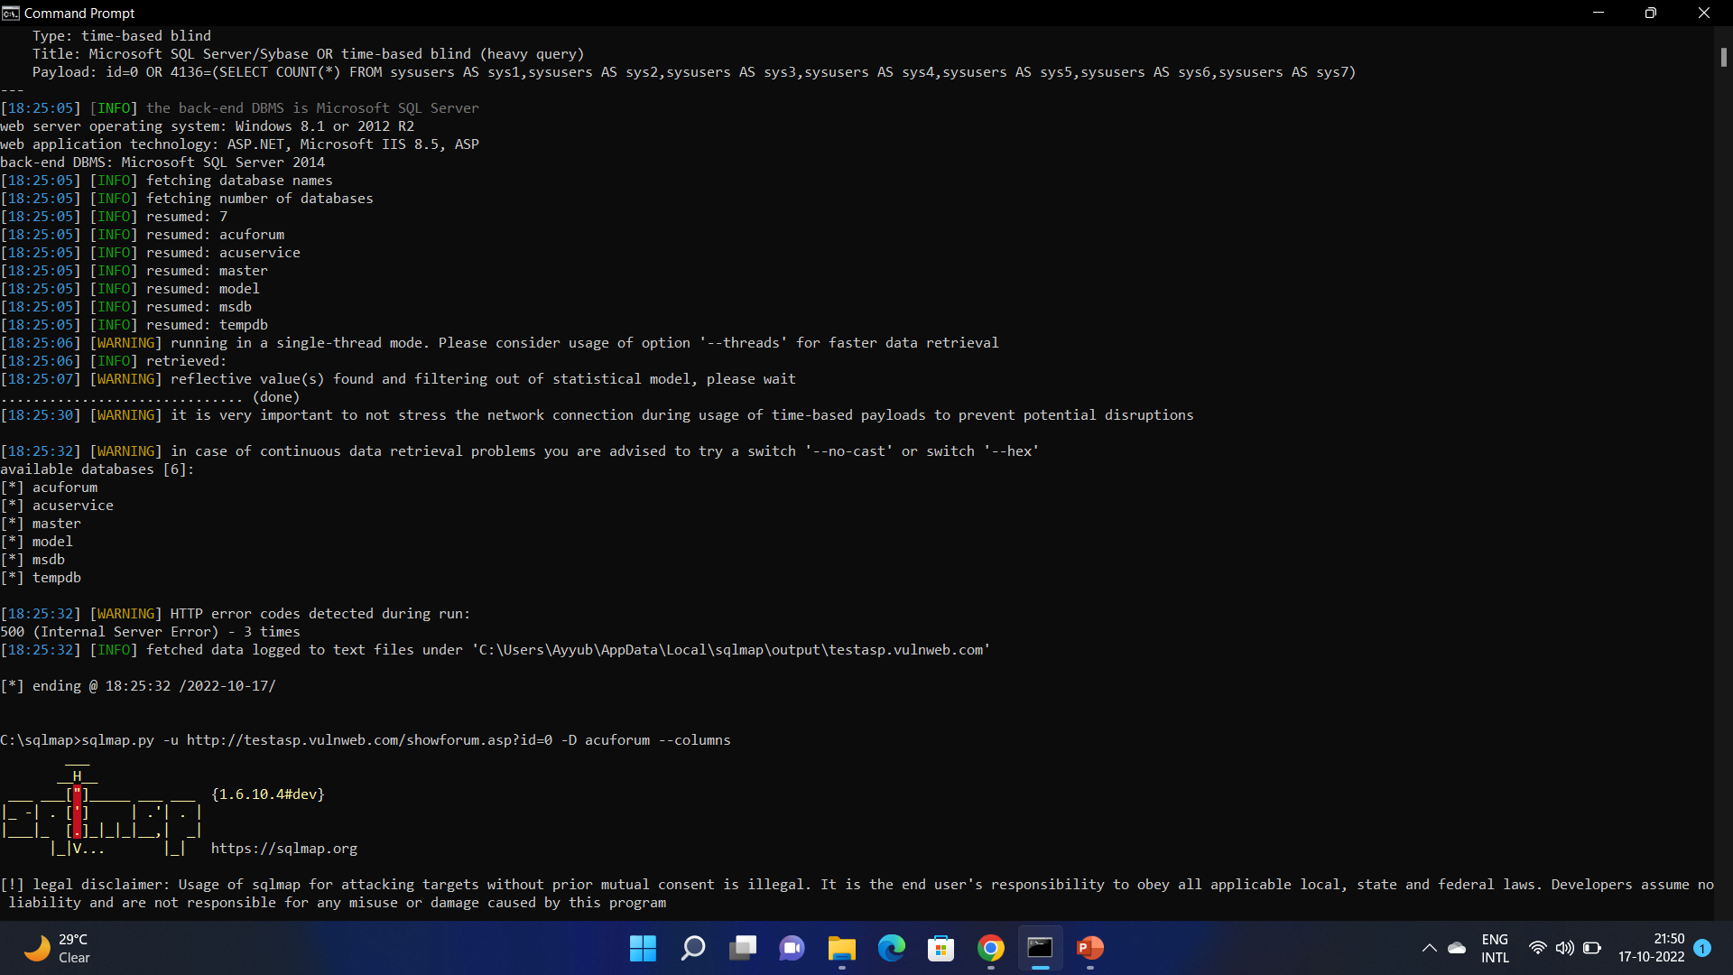
Proof of Concept
Available Databases Screenshot is shown below:

Slide 12
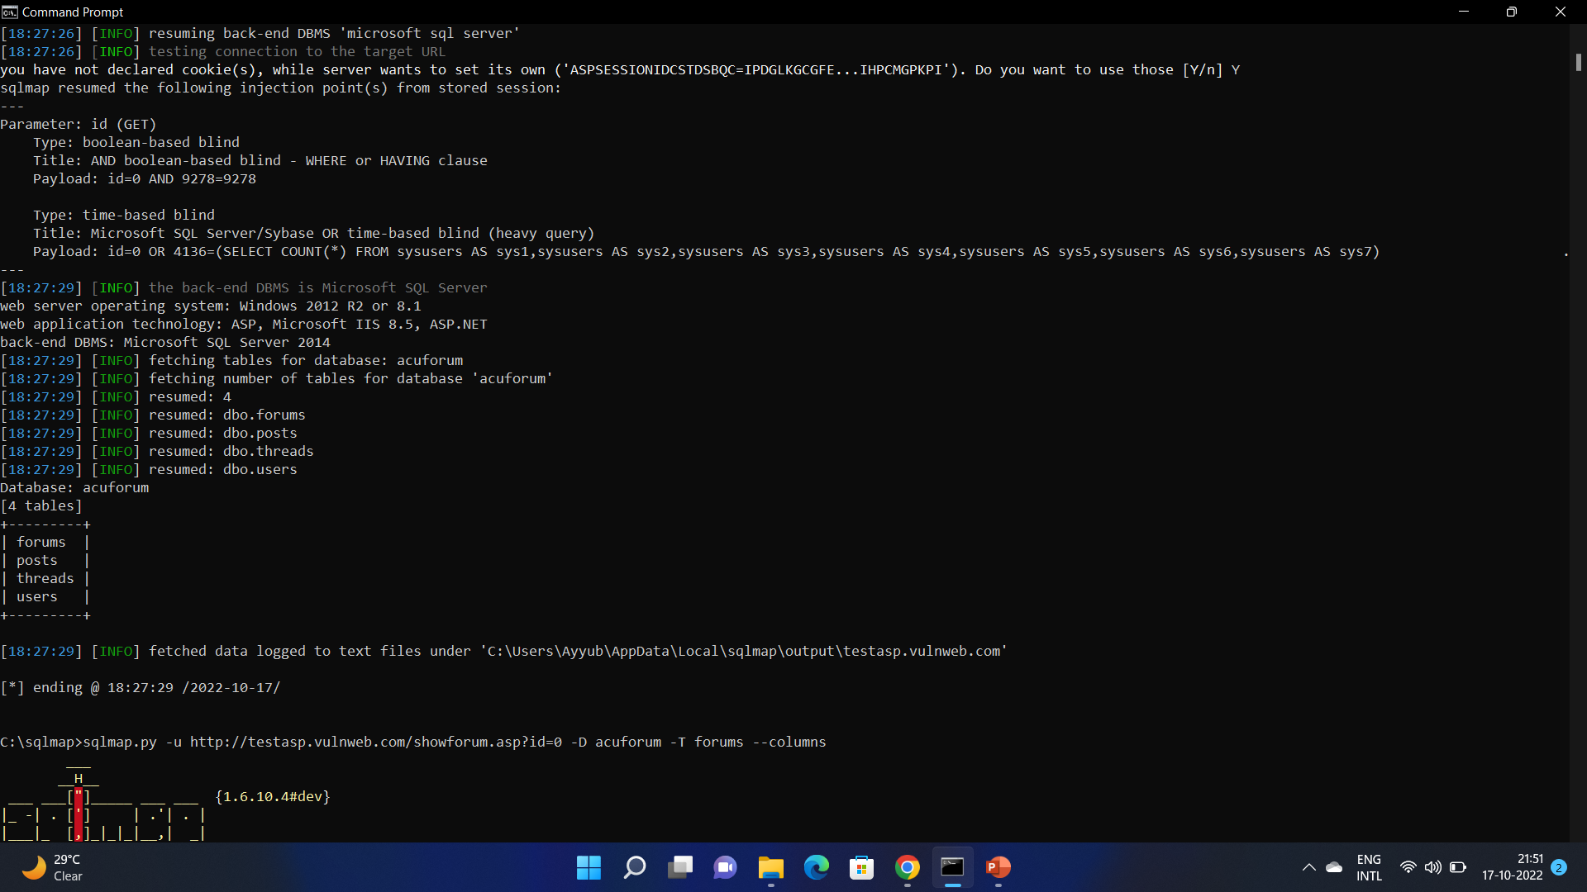
Available Tables in Acuforum Database Screenshot is shown below :

Slide 13
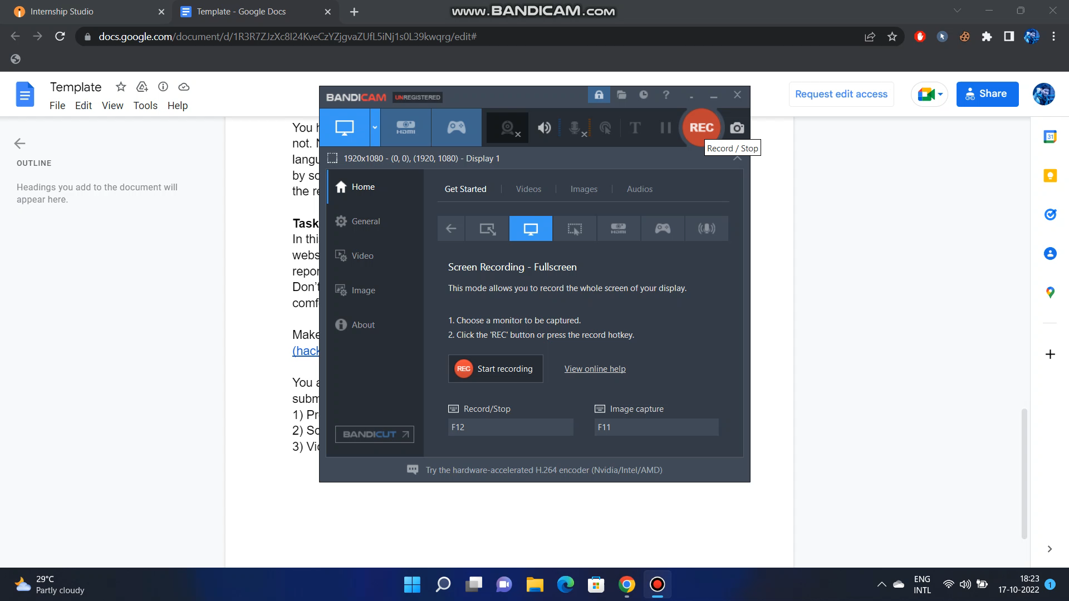
VIDEO DEMONSTRATION

Slide 14
THANK YOU

